Slide 1
Building Histogram on Large Datasets in Apache Flink
BDAPRO
Dieu Tran, Pandu Wicaksono, Shibo Cheng
2018-01-22

Slide 2
Agenda
Introduction
Progress
Difficulties
Next Plan

Slide 3
Introduction

Slide 4
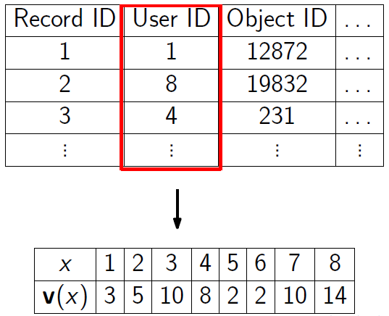
Histogram
Summarization tools
Any compact (lossy) representation of v
Domain
Frequency
Image Source: [1,2]
Notes:
A widely accepted and utilized summarization tools.
For an attribute x, domain of the attribute is finite and v(x) is the frequency vector of x.
A histogram is any compact (lossy) representation of v.

Slide 5
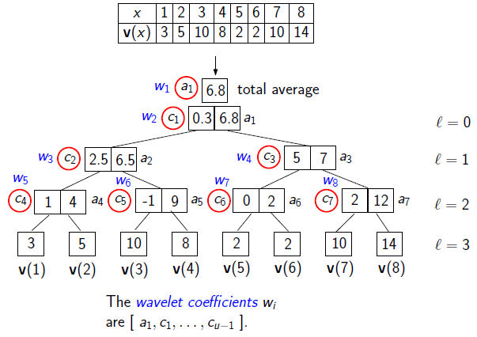
Wavelet Histogram
Haar wavelet histogram
Recursive approach
Top k coefficients → reconstruct the data
Image Source: [1,2]
Notes:
A common choice for a histogram is Haar wavelet histogram.
Obtain the wavelet coefficients recursively.
We can select the top k coefficients → can be used to reconstruct the data.

Slide 6
Histogram on Large Dataset
Histogram on MapReduce [1,2]
Evaluation:
Running time (IO and computation)
Network communication
The proposed algorithm:
Exact solutions
Approximate solutions

Slide 7
Goal
Main Goal: implementation in Flink and reproduce the experiment.
Algorithms:
Exact Solution
Send V
Send Coef
H-WTopK
Approximate solution
Basic-S
Improved-S
TwoLevel-S
Preferable datasets:
WorldCup dataset [3]
Synthethic dataset with Zypfian distribution

Slide 8
Experiment Metrics
Computation Cost
Time
SSE

Slide 9
Progress

Slide 10
Progress as of 21 January 2018
Main focus: Exact solution and initial experiment.
Implemented task:
Dataset preprocessing
Send V and Send Coef. implementation
SSE calculation from the algorithm result
Initial experiment on cluster
Reasons:
Exact solution → easiest
Dataset preprocessing → lot of time (1.35 billion records)
Need time to set up the experiment (evaluation metrics, configuration, etc.)
Avoid repeating the experiment (e.g. one of the metrics is missing)
Notes:
Main focus: implement the exact solution and perform initial experiment.
Implemented task:
Dataset preprocessing
Send V and Send Coef. algorithm implementation
SSE calculation from the algorithm result
Initial experiment on cluster
Reasons:
The exact solution is the easiest of the algorithm to implement.
Preprocessing the dataset requires a lot of time (1.35 billion records).
Need time to adapt using the cluster.
Need time to set up the experiment (evaluation metrics, configuration, etc.).
Avoid repeating the experiment (for example because the metrics is missing).

Slide 11
Dataset Preprocessing Flow
Data Source
WorldCup dataset
245 .txt files
{CID, OID, Timestamps}
245 .gzip files
245 binary files
(8 fields)
400 million records of mapping file
[1, 2^29]
{CID_OID, ID}
1.35 billion records of data files
{ID,ID,ID,ID…
ID,ID,ID,ID…}
1 file one file

Slide 12
Data Conversion
Timestamps
ClientID
ObjectID
Size
Method
Status
Type of file
Server
COID
4-bytes
1-bytes

Slide 13
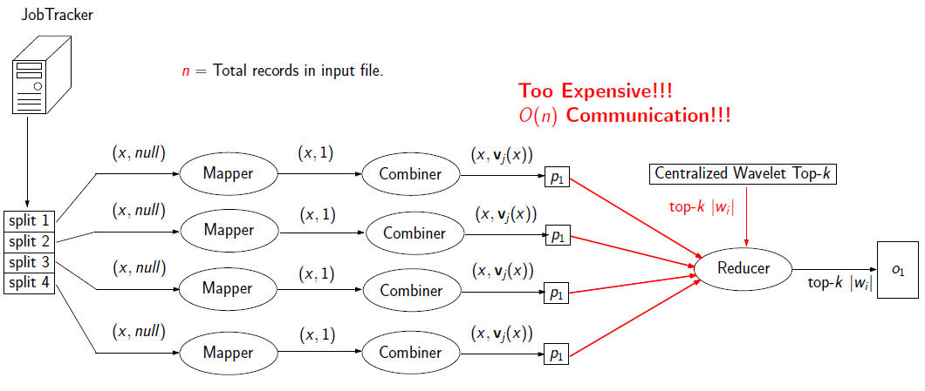
Implemented Algorithm (Send V and Send Coef.)
Send V → calculate the frequency in worker and send the frequency.
Send Coef. → calculate the local wavelet tree and send their coefficient.
Image Source: [1,2]

Slide 14
Send Coef. Bottleneck
Computation time and Communication Time
Send V → Calculate frequency and just send 3 values
Send Coef. → Calculate frequency, compute wavelet tree, send the coefficient
In Send Coef. even if the frequency is 0, sometimes still need to send some values if the coefficient is not 0 in the tree
4
2
3
3
2
3
2
4
Calculate Frequency
1
2
3
4
1
2
3
4
0
1
2
1
0
2
1
1

Slide 15
SSE Calculation
Send V and Send Coef. → output file containing the top k coefficient of the wavelet tree
SSE Calculation → take file, reconstruct the data, calculate
Notes:
Send V and Send Coef. write an output file containing the top k coefficient of the wavelet tree.
Implement a program to have this data as an input and reconstruct the data.
Compare the actual data with the reconstructed data to get the SSE.

Slide 16
Results
Send V → worked as intended (partial dataset 94 million of domain and 107 million records)
Send V → found OutOfMemory error using more data
Send V’s overall running time → around 1.5 hours (other algorithm should be less than this time).
Send Coef. → taking too much time, stopped the execution (the paper also didn’t present the result of Send Coef.)
Notes:
Send V worked as intended for partial dataset 94 million of domain and 107 million records.
Send V found OutOfMemory error using more data.
Send Coef. was taking too much time, hence we stopped the execution (in the paper, they also stopped the execution and didn’t present the result of Send Coef.)
Send V’s overall running time was around 2.5 hours → the other algorithm should be less than this time since Send V is the exact solution (slowest acceptable solution).

Slide 17
Progress in Other Solution
H-WTopK → need to understand how Flink State works
Algorithm utilize three steps of computation
Result of first phase → send to the worker of second phase
Basic-S → a slight modification of Improved-S
Improved-S → perform sampling during the exact solution computation
TwoLevel-S → currently still understanding the algorithm

Slide 18
Difficulties

Slide 19
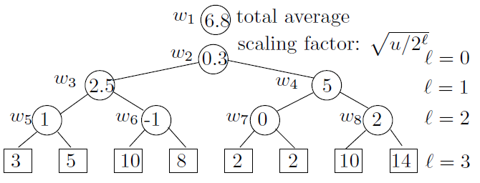
OutOfMemory and akka Timeout Error
GroupReduce is using a HashMap to store <id, frequency> → domain is too big for the memory (solved by changing Flink configuration)
Increasing Heap Size → akka timeout error due to Garbage Collection taking too much time
Frequency
Image Source: [1,2]

Slide 20
OutOfMemory and AKKA Timeout Error (2)
TaskManager heap size = 49G → OutOfMemory exception
Change taskmanager heap size from 49G to 59G → TaskManager was killed/lost
TaskManager heap size 59G, increase akka time out from 600s to 6000s, akka.lookup.timeout from 100s to 1000s → get back to OutOfMemory error
Decrease TaskManager memory size to 40G → TaskManager was killed/lost error again
Decrease TaskManager Memory size to 35G → TaskManager was killed/lost error

Slide 21
Implementing the algorithm
Reading the paper and understanding the algorithm from it was hard.
Many mathematical notation
Sometimes the explanation is not very clear
Cannot directly implement the algorithm in Flink
Plan to deal with the problem:
Search for another source to help → we have obtained a slides from the same author that explains the implementation
Search for the implementation source code → we have obtained the research implementation source code in MR

Slide 22
Getting the Metrics from Flink
First time using Flink and cluster to run the experiment
Don’t really know from which data the metrics is obtained (Flink log / GUI interface / etc.)
Plan to deal with the problem:
Reading through the Flink documentation
Asking a more experienced Flink user

Slide 23
Next Plan

Slide 24
Timeline

Slide 25
References
[1] Jestes, Jeffrey, Ke Yi, and Feifei Li. Building wavelet histograms on large data in MapReduce. Presentation Slides from https://www.cs.utah.edu/~lifeifei/papers/histogramSlides.pdf (Accessed 18 January 2018).
[2] Jestes, Jeffrey, Ke Yi, and Feifei Li. Building wavelet histograms on large data in MapReduce. Proceedings of the VLDB Endowment 5.2 (2011): 109-120.
[3] http://ita.ee.lbl.gov/html/contrib/WorldCup.html (Accessed 18 January 2018)

